Slide 1
Spatial Correlation and Variogram
GEOL0097 - Geostatistics
University of Liège
Milkias Z. SEMEREAB
MilkiasZerai.Semereab@uliege.be

Slide 2
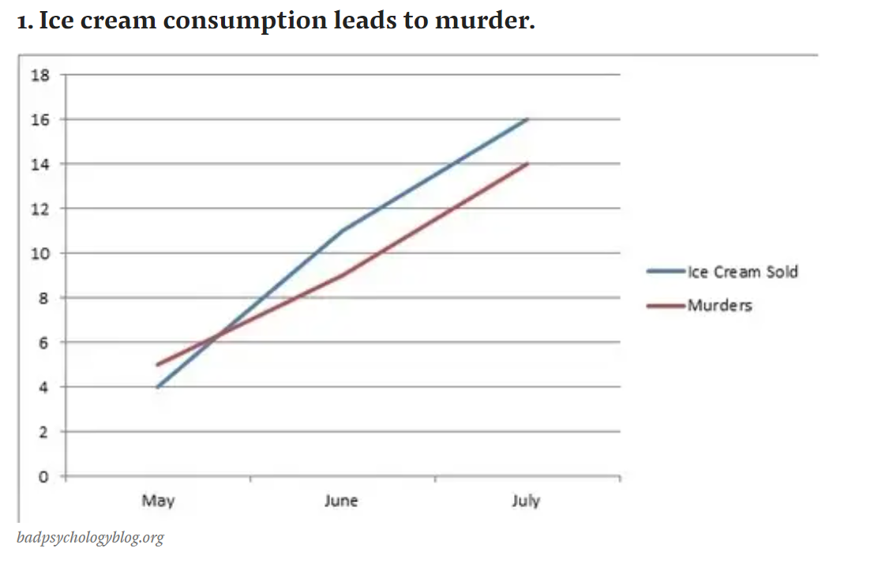
Bizarre Correlations ;-)
Correlation doesn't always imply causation!
Geostatistics

Slide 3
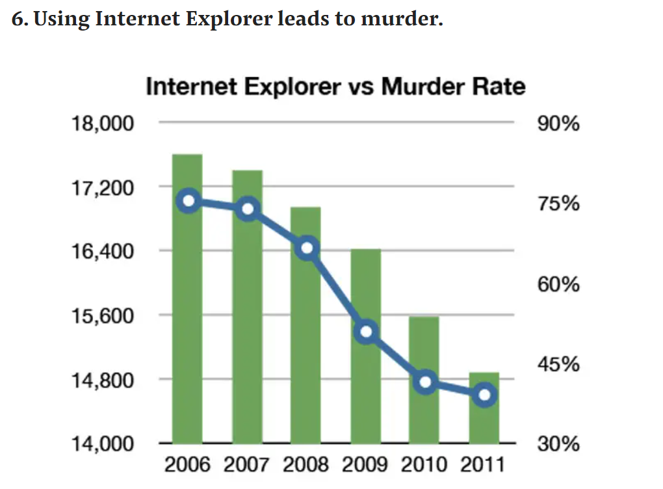
Bizarre Correlations ;-)
Correlation doesn't always imply causation!
Geostatistics

Slide 4
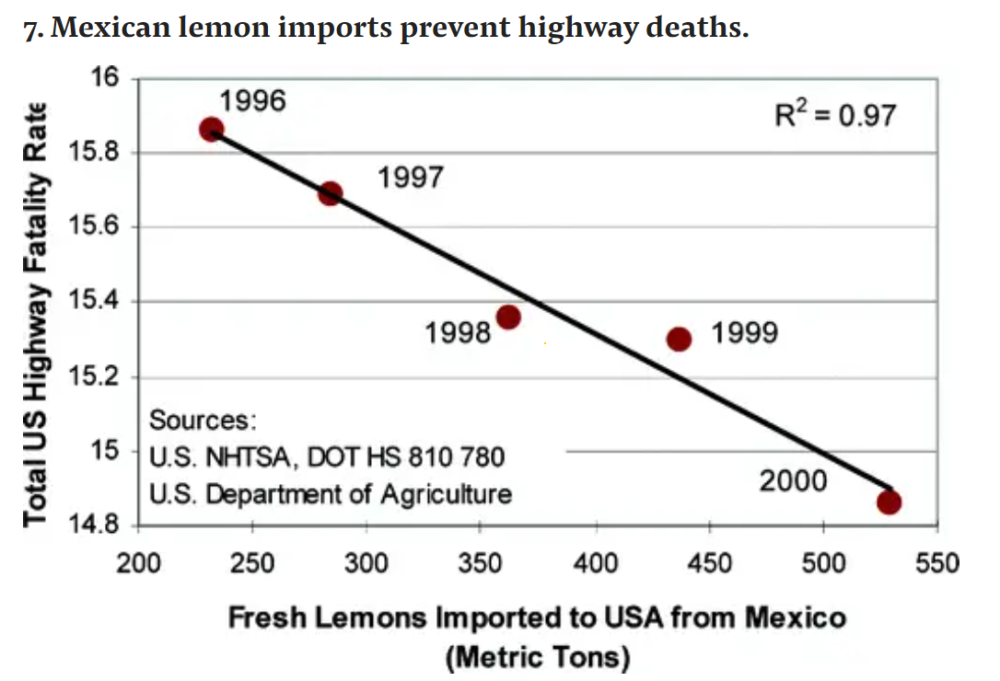
Bizarre Correlations ;-)
Correlation doesn’t always imply causation!
Geostatistics

Slide 5
GitHub Repository
Meuse data description
Meuse samples location in Google Map
Sampling area dimensions?
Number of bins in hist() function
Sample distribution Map versus Scatter plot
Why I am using R-Notebook (R-Markdown)
Geostatistics
# cadmium distribution plot(data[,1],data[,2],pch=16,cex=2*(data[ ,3] - min(data[ ,3]))/(max (data[ ,3]) - min(data[ ,3])),xlab = "Easting(m)", ylab = "Northing(m)", main="cadmium concentrations (ppm)",asp=1)

Slide 6

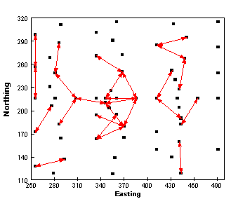
Omni-directional Variogram
The experimental variogram function:
Geostatistics

Slide 7
RGeost
Plot the experimental variograma
The variogram should not be calculated for D > than half of the geometric domain
Define lag size
In practice, we don’t have enough data pairs at a given distance
Lag tolerance
Half of lag size
Define number of lags
Enough number of pairs for each lag
Choose a lag as small as possible so that short-range variation is not smoothed away
Directional variograma (Detect Anisotropy)
4 directions: 0, 45°, 90° and 135°; 3D data: 0/90°
Geostatistics

Slide 8
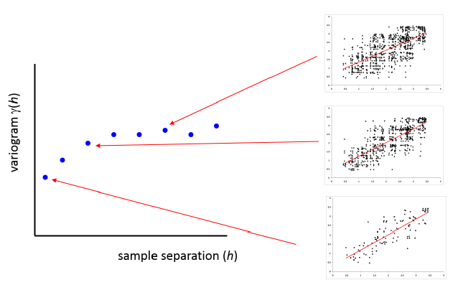
Omni-directional Variogram
The experimental variogram function:
Geostatistics

Slide 9
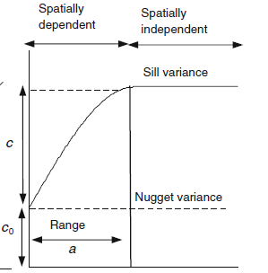
Variogram
Geostatistics

Slide 10
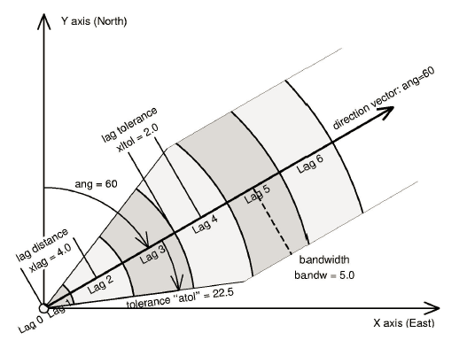
Directional variogram
We don’t have enough data pairs at a given distance and in a given direction, Hence we create classes with some tolerance
Geostatistics

Slide 11
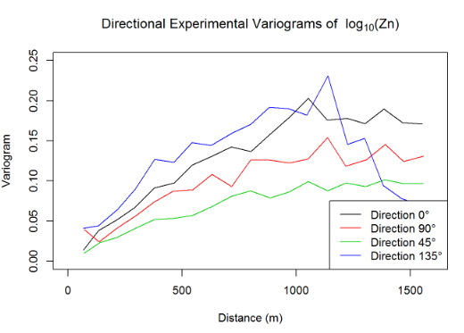
Directional Variogram
sqrt((max(data[,1])-min(data[,1]))^2 + (max(data[,2])-min(data[,2]))^2) # Diagonal Geographic Domain
ndir=4 # Number of Directions
ang0=0 # 1st Direction
dirvect=((seq(1,ndir)-1) * 180 / ndir+ ang0)
# Directions
nlag=10 # Number of lags
Vario_E2=vario.calc(db.data,dirvect=dirvect,lag=D/(2*nlag),nlag=nlag)
Vario_E2
Geostatistics

Slide 12
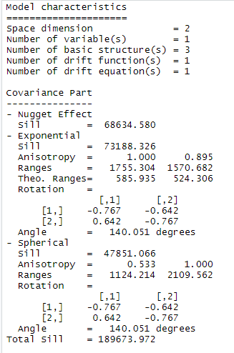
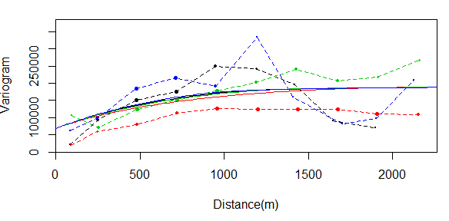
Variogram
Geostatistics

Slide 13
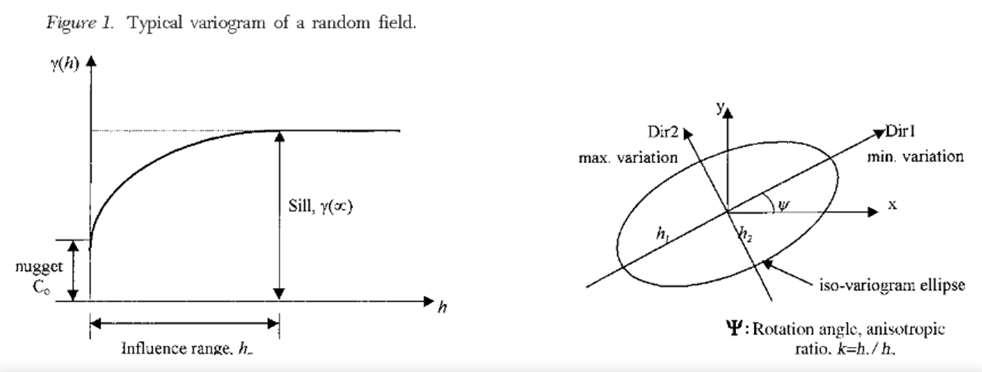
Directional Variogram
Geostatistics

Slide 14
Variogram
Geostatistics

Slide 15
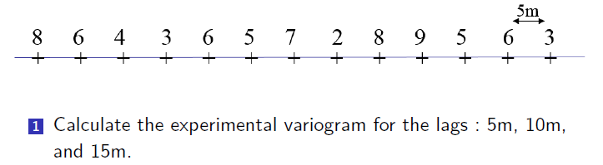
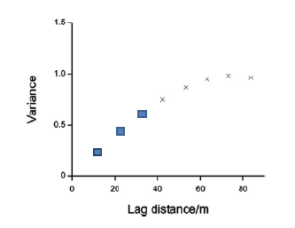
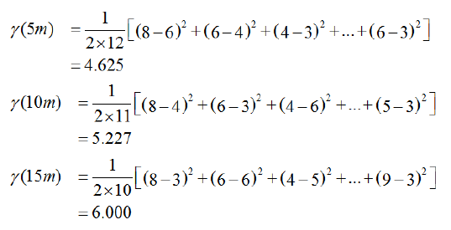
Variogram
Geostatistics

Slide 16
Variogram
Geostatistics

Slide 17
Variogram
Geostatistics

Slide 18
Omni-directional Variogram
The experimental variogram function:
Geostatistics

Slide 19
Omni-directional Variogram
The experimental variogram function:
Geostatistics

